Slide 1
IE Organizational Building Leadership Program
Session 2: Leveraging Your Identity as a Leader -
Understanding Culture & Your Identity
August 8, 2024

Slide 2
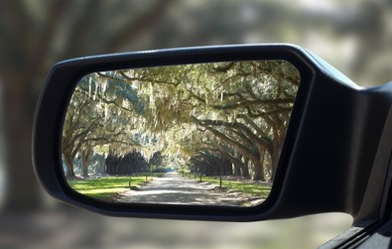
General Reflections on Last Session
Notes:
Share in chat or unmute and share
Nonprofit Landscape (IE: by revenue by sector, challenges facing np orgs, revenue by region)
Core pillars of NPs: Strategic Vision & Planning / Resource Management & Sustainability / Mission-Driven Leadership & Culture / Stakeholder Engagement & Advocacy)
Leadership vs Management / Changing paradigms of leadership
Delegating, Supporting, Coaching, Directing
Grounded leader: Six Disciplines – Physical, Emotional, Intellectual, Social, Vocational, Spiritual
Leadership Manifesto handout

Slide 3
Session 2
Panel Discussion: Our journeys of growth and identity
Exploring Culture and Identity
Generations at Work (as an example on team diversity)
Strategies for Inclusive Leadership
Upcoming Sessions & Final Reflections

Slide 4
Group Agreements
Be present
Participate – interaction
Step up/back
Listen without judgement
Share the message, not the messenger
Talk from your experience
Be open to new ideas
Learn from each other
Be respectful with electronics

Slide 5
Panel Discussion: Our Journeys of Growth and Identity
Notes:
Part 1

Slide 6
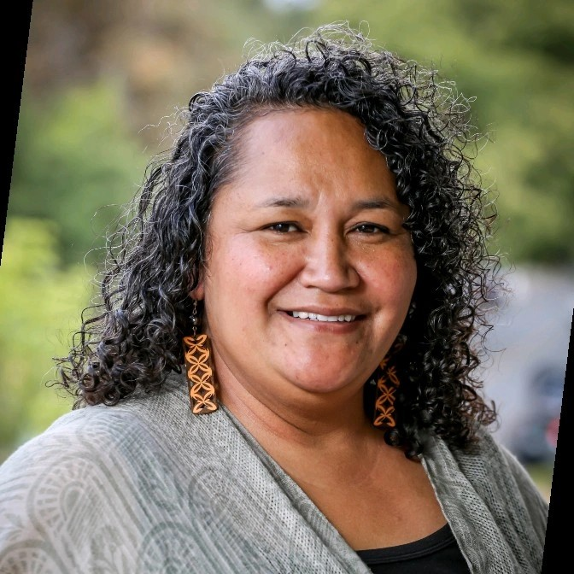
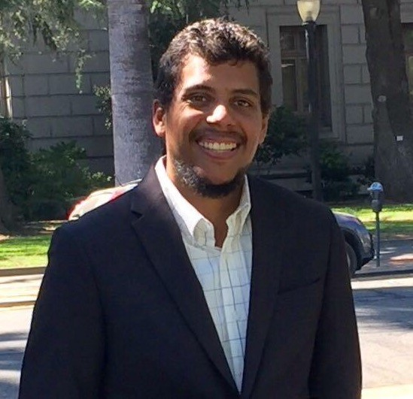
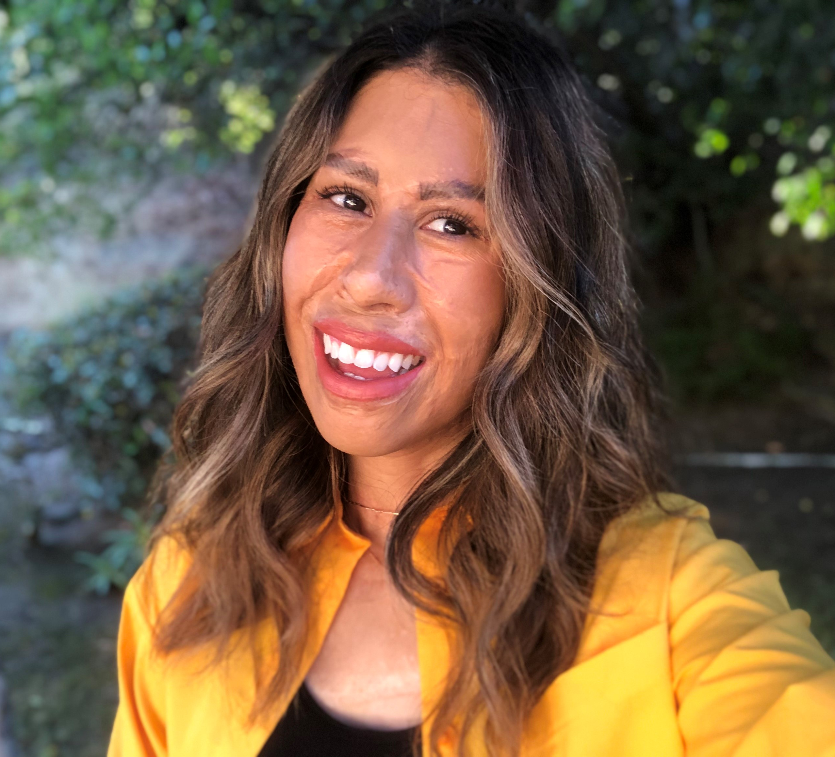
Panel Discussion
Lolofi Soakai
(She/Her)
Executive Director
M.A.L.O (Motivating Action Leadership Opportunity)
Panelist
Suzie Gomez
(She/Her)
President & CEO
Inland Empire
Community Collaboration
Panelist
Malek Bendelhoum
(He/Him)
Co-Founder &
Executive Director of Sahaba Initiative
Moderator
Michelle Escamilla
(She/Her)
Learning & Outreach Manager
Center for Nonprofit Management
Moderator
Notes:
Questions:
Tell us about yourself and your professional journey.
How have your diverse identities and cultural background influenced your leadership?
How have your experiences (whether successes or adversity) shaped your approach to leadership/growth/even mentorship?
As a leader, how have you navigated the responsibility or expectation to represent your entire identity group?
How do you stay resilient and motivated when encountering systemic barriers or discrimination in the work field?
Anything else you would like to share with our participants today?

Slide 7
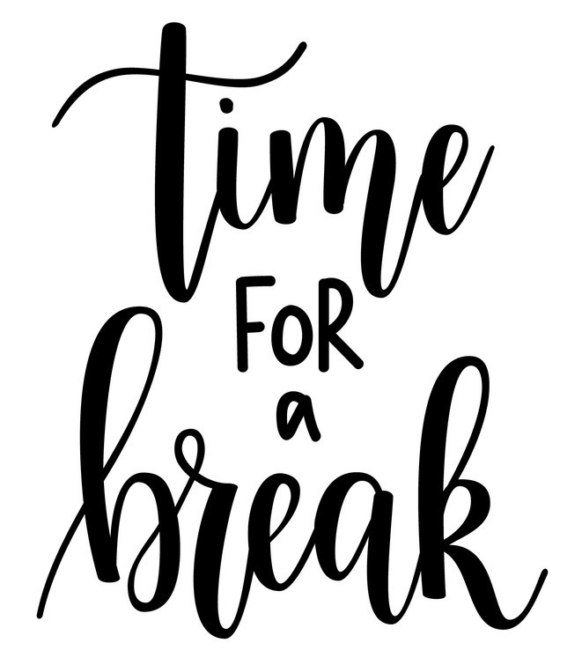

Slide 8
Exploring Culture & Identity

Slide 9
Culture & Identity
When you think about diversity at work, what different elements come to mind?
Notes:
Race
Ethnicity
Gender identity
Age
Religion / Beliefs
# of years at organization
Work experience
Education
Languages
Cultural backgrounds
Disability
Socioeconomic status
Nationalities
Personal values
…

Slide 10


Individual's identity & culture can significantly influence:
Communication style
Interactions (with coworkers, clients, volunteers, etc.)
Decision-making process
Approach to authority & hierarchy
Conflict resolution style
Teamwork & collaboration
Work-life balance
…and more

Slide 11
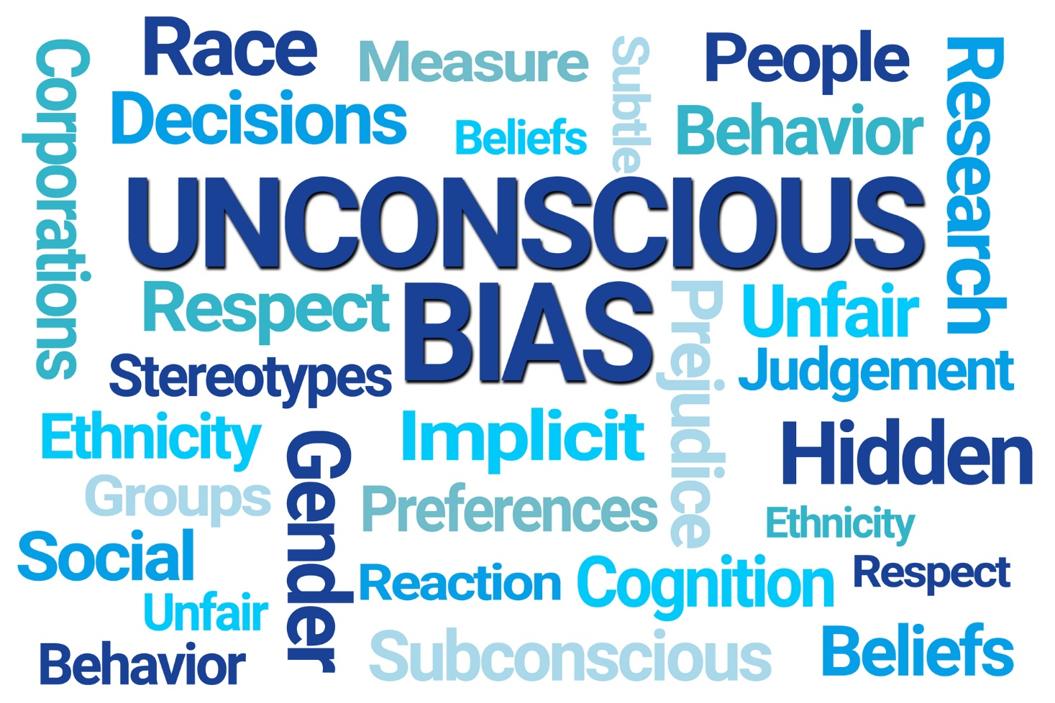
Notes:
Unconscious bias is a social stereotype that people form about others, often unintentionally and outside of their conscious awareness.
It can be caused by societal stereotypes, personal experiences, cultural conditioning, and media influences.
[Work setting] When unchecked, unconscious bias can have negative effects on a team, such as creating unfair advantages or disadvantages for employees. This can lead to low morale, high turnover, and low productivity.
(^^ example: Affinity Bias – Friends [chandler & his boss] ... The Office [michael scott & Jim halpert vs Dwight]
Example: A team leader tends to favor employees who share similar interests, backgrounds, or personalities. They may provide more support, mentorship, and opportunities to these employees, consciously or unconsciously.
Impact: This can result in a lack of diversity in thought and innovation, as well as feelings of exclusion among other team members, potentially leading to reduced productivity and job satisfaction.
Understanding how our own biases affect us can offer better insight into how we might be influencing others in their job.
(consider how might you be influencing others in their jobs?)

Slide 12
Message
Sender
Receiver
Coding
Decoding
Notes:
Identity, culture, past experiences, bias, etc. influence how we code and decode messages.

Slide 13
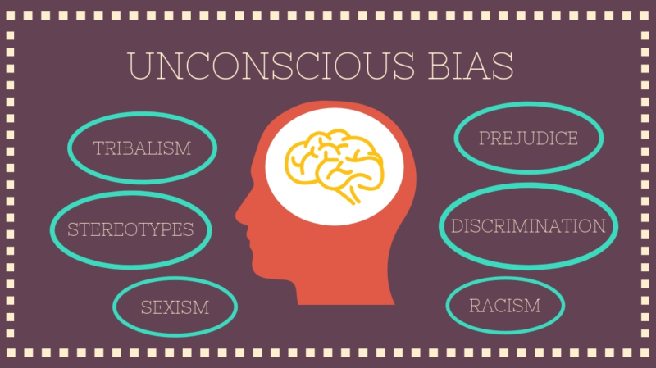

Slide 14
Bias Beware
Contrast
Recency/ Latency Effect
Halo Effect
BIAS
Central Tendency
Horn Effect
Excessive Strictness/ Leniency
Notes:
This slide explains various biases that we all must be aware of in the all the work that we do. By nature as humans, all of us have biases which are ingrained in our thinking – while we cannot rid ourselves of biases, we can be aware of them.
What is a Bias?
Bias - When an appraiser’s values, beliefs, or prejudices distort ratings (either consciously or unconsciously). Note that national origin, age, religion, gender, appearance, or other non-job-related factors may influence the rater to distort appraisal information.
Halo/Horn Effect - A halo effect occurs when an employee is extremely competent in one area and is therefore rated high on all categories. Conversely, a horn effect may occur when one weakness results in an overall low rating (Example: If a mechanic is customer-service-oriented and well-liked by customers, the rater may give the employee high ratings in other areas too. In contrast, a weak mechanic may receive a low rating in every category because he is weak in customer service skills.).
Strictness/Leniency - Some appraisers may be reluctant to give high ratings. Appraisers who believe that standards are too low may inflate the standards in an effort to make the standards meaningful in their eyes (Example: An appraiser believes that very few employees should be rated as excellent performers. Most of his high performers receive lower ratings than employees who report to other managers in the department ). Leniency errors are the result of appraisers who don’t want to give low scores. All employees in this case are given high scores (Example: An appraiser does not like to give low scores because he feels that it is demotivating to employees and causes conflict. Instead he gives all employees high ratings.).
Central Tendency - Central tendency occurs when an appraiser rates all employees within a narrow range, regardless of differences in actual performance (Example: The appraiser may act like a teacher who gives most students Cs even though large differences exist in performance. The appraiser sees all employees as average.).
Recency/Latency Effect - The recency error occurs when the appraiser gives more weight to recent occurrences and discounts the employee’s earlier performance (Example: In the last 2 months of the year, an employee does an excellent job in training new employees – a job he particularly likes. However the first ten months his performance was average and often inconsistent. His boss rates him on his most recent performance.) Primacy – when appraiser gives more weight to an employees earlier performance and discounts recent occurrences.
Contrast - Contrast error occurs when an employee’s rating is based on how his or her performance compares to that of another employee instead of on objective performance standards (Example: Instead of rating an employee against performance standards, a manager picks a fellow employee as a yardstick. If the appraiser thinks that the employee is better than his fellow employees, his rating is higher.)
Questions to Ask:
What bias might I tend toward?
What bias have I experienced in the past?

Slide 15
Generations at Work (as an example on team diversity)

Slide 16

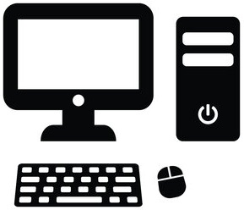

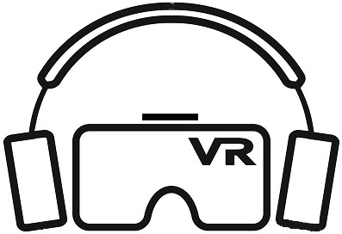
(age in 2023) | Baby Boomers Born 1946-1964 Ages: 59 to 77 | Gen X Born 1965-1979 Ages: 44 to 58 | Millennials Born 1980-1994 Ages: 29 to 43 | Gen Z 1995-2012 Ages: 11 to 28
Career Attitudes | Workplace Loyalty Career Ladder Team-Oriented | Career Loyalty Career Lattice Independent | Flat Leadership Transparency Goal-Oriented | High Ambitions Entrepreneurial Self-Directed
Expectations & Incentives | Advancing Titles Retirement Plans | Family-Flexible Fair Pay & Benefits | Work-life Balance Mentor not Manage | Individuality Flexible Stability
Formative Life Experiences | Nuclear Families Firm Gender Roles Vietnam War / Cold War Civil & Women’s Rights Movements Moon Landing | 'Latchkey’ Kids, Divorce, Dual Career Families Fall of Berlin Wall AIDS Epidemic Birth of Internet & PCs The dot-com boom | 9/11 Attacks Tech is for Play 1 in 3 is an Only Child Internet & Social Media Mass shootings Immediacy | ‘Digital Natives’ Social Everything School Shootings Reality TV Great Recession COVID Non-Binary Culture
Key Technology | TV | PC | Smartphone | AR / VR
Notes:
This table represents broad generalizations -- external forces that may influence key characteristics & how individuals from certain generations behave
Generational studies are intended to help you notice traits, trends, commonalities, to create a welcoming team and to better understand the individuals who make up your team
Key Context to keep in mind as a supervisor…..
Generations Discussion
Traditionalists / The Silent Generation – Economic Hardship, discipline, self-sacrifice, deferred gratification, civic duty, loyalty, ‘Pull Yourself up by your Bootstraps’
Pop Culture: It’s a Wonderful Life
Boomers – largest generation in modern history; ’Nuclear families’ – stay at home Moms cared for most Boomers
Grew up to be ’rebels’ – civil & women’s rights, nuclear disarmament, sexual freedom, consumer advocacy, environmental awareness
See change as painful, inevitable
Entered workforce en masse; Career Ladder - Hard work is what it takes = long hours as ’badge of honor’
Also birthed team-orientation at work
Pop-Culture: Leave it to Beaver

Slide 17
(age in 2023) | Baby Boomers Born 1946-1964 Ages: 59 to 77 | Gen X Born 1965-1979 Ages: 44 to 58 | Millennials Born 1980-1994 Ages: 29 to 43 | Gen Z 1995-2012 Ages: 11 to 28
Career Attitudes | Workplace Loyalty Career Ladder Team-Oriented | Career Loyalty Career Lattice Independent | Flat Leadership Transparency Goal-Oriented | High Ambitions Entrepreneurial Self-Directed
Expectations & Incentives | Advancing Titles Retirement Plans | Family-Flexible Fair Pay & Benefits | Work-life Balance Mentor not Manage | Individuality Flexible Stability
Formative Life Experiences | Nuclear Families Firm Gender Roles Vietnam War / Cold War Civil & Women’s Rights Movements Moon Landing | 'Latchkey’ Kids, Divorce, Dual Career Families Fall of Berlin Wall AIDS Epidemic Birth of Internet & PCs The dot-com boom | 9/11 Attacks Tech is for Play 1 in 3 is an Only Child Internet & Social Media Mass shootings Immediacy | ‘Digital Natives’ Social Everything School Shootings Reality TV Great Recession COVID Non-Binary Culture
Key Technology | TV | PC | Smartphone | AR / VR
Notes:
GenX – rise of live TV = More cautious and less optimistic about future
Came of age in dual career households, rising divorce rates, latchkey kids = Pragmatic, self-reliant
Give them a goal and get out of the way
Career Lattice not Career Ladder; will forego professional growth if it comes at expense of personal development – work they value
Pop-Culture: MTV, Goonies

Slide 18
(age in 2023) | Baby Boomers Born 1946-1964 Ages: 59 to 77 | Gen X Born 1965-1979 Ages: 44 to 58 | Millennials Born 1980-1994 Ages: 29 to 43 | Gen Z 1995-2012 Ages: 11 to 28
Career Attitudes | Workplace Loyalty Career Ladder Team-Oriented | Career Loyalty Career Lattice Independent | Flat Leadership Transparency Goal-Oriented | High Ambitions Entrepreneurial Self-Directed
Expectations & Incentives | Advancing Titles Retirement Plans | Family-Flexible Fair Pay & Benefits | Work-life Balance Mentor not Manage | Individuality Flexible Stability
Formative Life Experiences | Nuclear Families Firm Gender Roles Vietnam War / Cold War Civil & Women’s Rights Movements Moon Landing | 'Latchkey’ Kids, Divorce, Dual Career Families Fall of Berlin Wall AIDS Epidemic Birth of Internet & PCs The dot-com boom | 9/11 Attacks Tech is for Play 1 in 3 is an Only Child Internet & Social Media Mass shootings Immediacy | ‘Digital Natives’ Social Everything School Shootings Reality TV Great Recession COVID Non-Binary Culture
Key Technology | TV | PC | Smartphone | AR / VR
Notes:
Millennials – (aka Gen Y)
Flat Leadership (less about hierarchy, sharing responsibility), Transparency, Consensus … because:
1/3 were only child – Focused attention from parents
Era of the participation trophy; Earned reputation of being narcissistic; overconfident; entitled
Latchkey kids now ‘Free range parenting’ = neglect
Ever-present To Do list & evolution of quantified self (Fitbit, 23&Me…) = goal-oriented & efficient but often perceived to have less initiative
Highest likelihood to have unmet expectations & lowest satisfaction in career
Pop-Culture: Fantastical, optimistic - Disney Channel Movies, Harry Potter

Slide 19
(age in 2023) | Baby Boomers Born 1946-1964 Ages: 59 to 77 | Gen X Born 1965-1979 Ages: 44 to 58 | Millennials Born 1980-1994 Ages: 29 to 43 | Gen Z 1995-2012 Ages: 11 to 28
Career Attitudes | Workplace Loyalty Career Ladder Team-Oriented | Career Loyalty Career Lattice Independent | Flat Leadership Transparency Goal-Oriented | High Ambitions Entrepreneurial Self-Directed
Expectations & Incentives | Advancing Titles Retirement Plans | Family-Flexible Fair Pay & Benefits | Work-life Balance Mentor not Manage | Individuality Flexible Stability
Formative Life Experiences | Nuclear Families Firm Gender Roles Vietnam War / Cold War Civil & Women’s Rights Movements Moon Landing | 'Latchkey’ Kids, Divorce, Dual Career Families Fall of Berlin Wall AIDS Epidemic Birth of Internet & PCs The dot-com boom | 9/11 Attacks Tech is for Play 1 in 3 is an Only Child Internet & Social Media Mass shootings Immediacy | ‘Digital Natives’ Social Everything School Shootings Reality TV Great Recession COVID Non-Binary Culture
Key Technology | TV | PC | Smartphone | AR / VR
Notes:
Gen Z aka Gen2020 (>1996)
Children of older parents, small, dual income families
Most technologically advanced generation yet – born into a fully digital world
Prefer to text than talk
Want/need to gather and share information on-demand
Expect collaboration from leaders and to be viewed as equal partners
Children during the 2007-09 recession; witnessed their families losing their jobs, houses, livelihoods
Shift toward Non-binary culture: 2000 Census = first time you could select more than one race – previously you would be recategorized if you picked >1
Pop Culture: Pessimistic; dystopian, rather than fantastical, world – Hunger Games, Divergent
LEVERAGE IT ALL :
Address & take advantage of the differences in values & expectations of each generation
Boomers want to share their talents, Gen X will tell you what won’t work, millennials want to learn what to do, Gen Z wants to make it more efficient – take advantage of these diverse skillsets and attitudes

Slide 20
Small Group Discussion:
Using this generational example, discuss how understanding each difference can leverage/celebrate/enhance your team.
How will we continue to learn/unlearn to leverage/celebrate/enhance [fill in the blank]?
Discoveries, questions, curiosities?
Notes:
Move to groups

Slide 21
Strategies for Inclusive Leadership

Slide 22
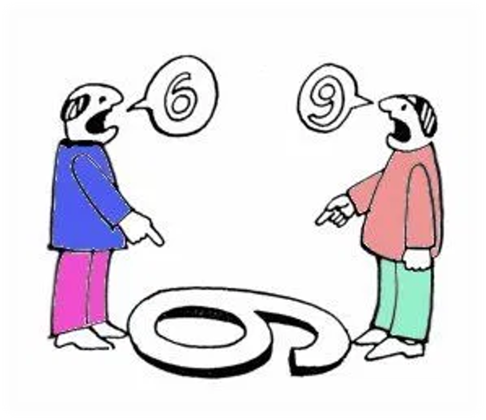
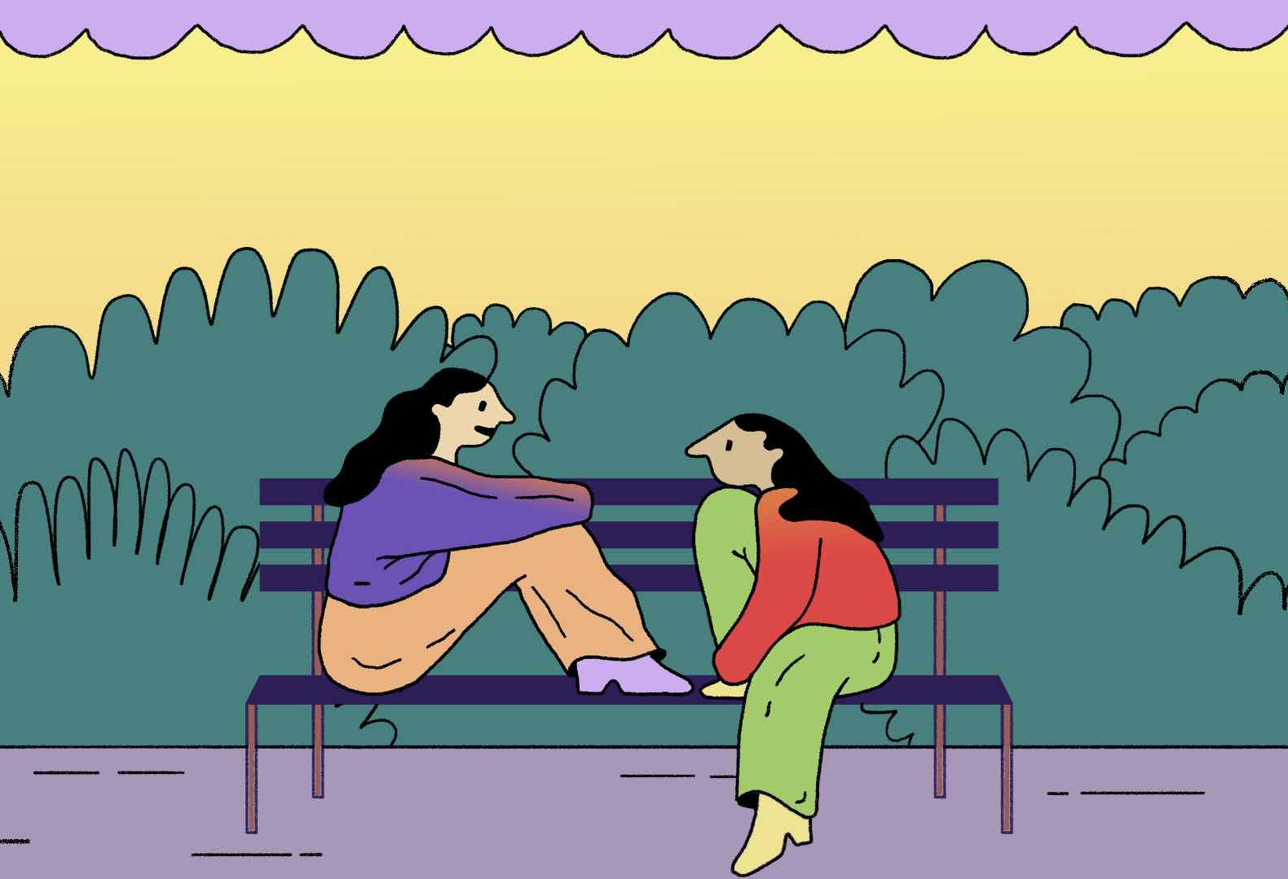
Listening

Slide 23
Most people don't listen with intent to understand;
they listen with intent to reply.
-Stephen Covey
Listening is about being present,
not just about being quiet.
-Krista Tippett

Slide 24
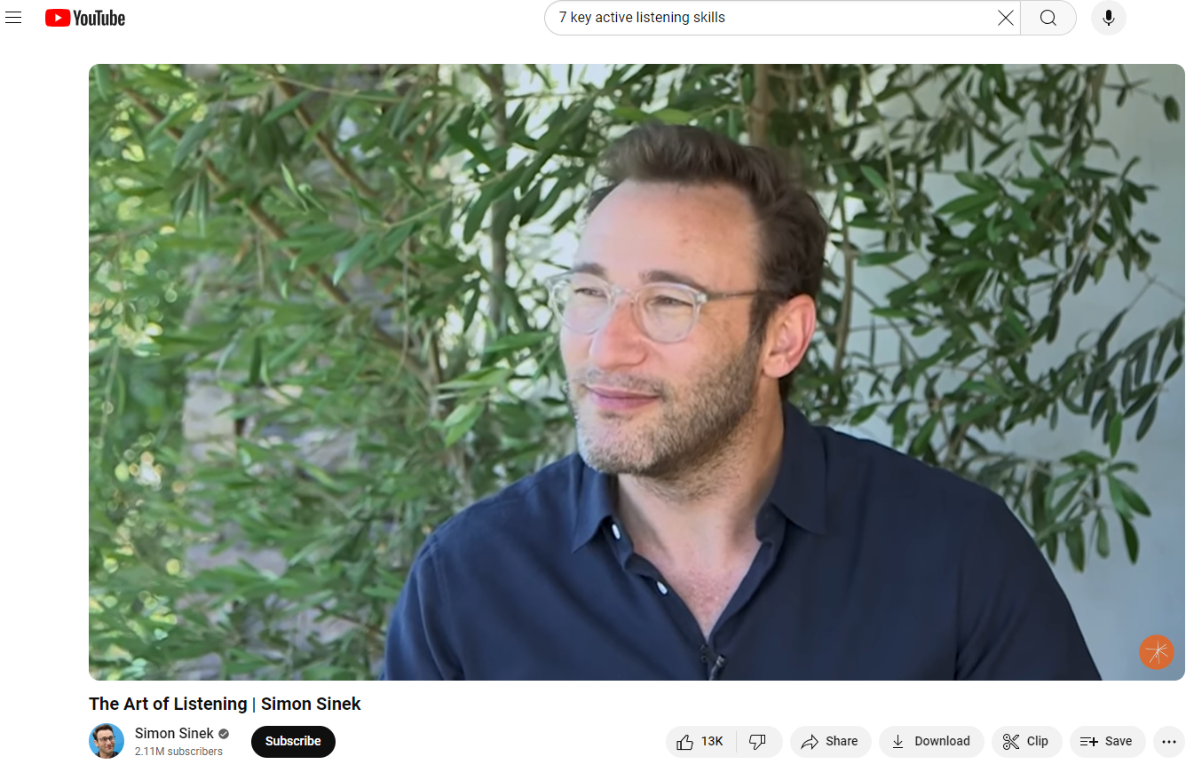
The Art of Listening by Simon Sinek
Notes:
https://www.youtube.com/watch?v=qpnNsSyDw-g

Slide 25
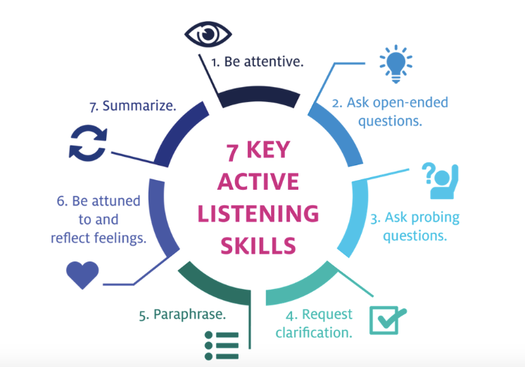

Slide 26
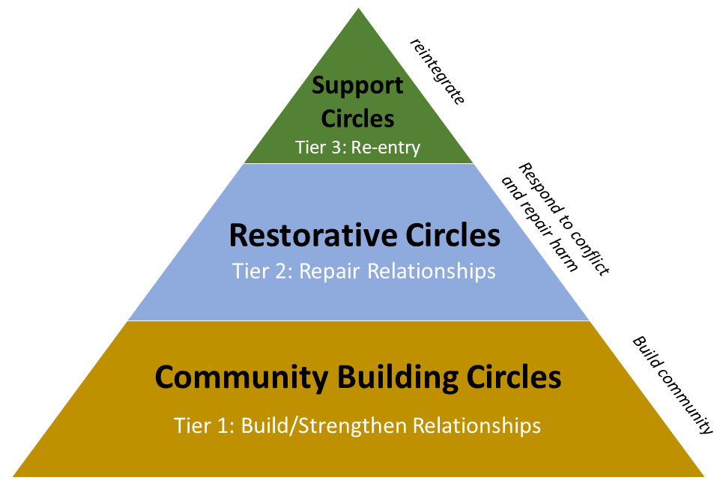
Restorative Practices
Lifelong learning
Repairing
* Listening *

Slide 27
Small Group Discussion:
Thorn & Rose: What stands out to you from this content? Are there any pain points/challenges to these strategies?
What strategies have you found work/do not work to foster inclusive leadership?
Discoveries, questions, curiosities along the way?
Notes:
Move to groups
Thorn & Rose: What stands out from the mentioned strategies? Are there any pain points/challenges to these strategies?
Q: What strategies have you found work/do not work to foster inclusive leadership?
Q: Discoveries, questions, curiosities?

Slide 28
Strategies for Inclusive Leadership
Active & engaged listening
Building trust
Clear, timely and effective communication regularly (feedback)
Acknowledge your unconscious biases
Celebrate & respect differences
Lifelong commitment to learning & unlearning
Establish inclusive policies and practices within the organization
Notes:
Cultivating a workplace where diverse perspectives are not just present but actively encouraged, it is essential to create spaces for open dialogue.
Promoting open discussions about diversity and inclusion allows employees to share their experiences and insights, fostering a culture of trust and mutual respect.

Slide 29
Upcoming Sessions

Slide 30
Date | Session Topic
Aug 29 (Virtual) | Fostering Organization and Individual Resiliency
Sept 19 (Virtual) | Traits of Highly Effective Organizations
Oct 10 (In-Person) | Implementing Succession Planning for Sustainable Organizations

Slide 31
Final Reflections

Slide 32

Questions?
32

Slide 33
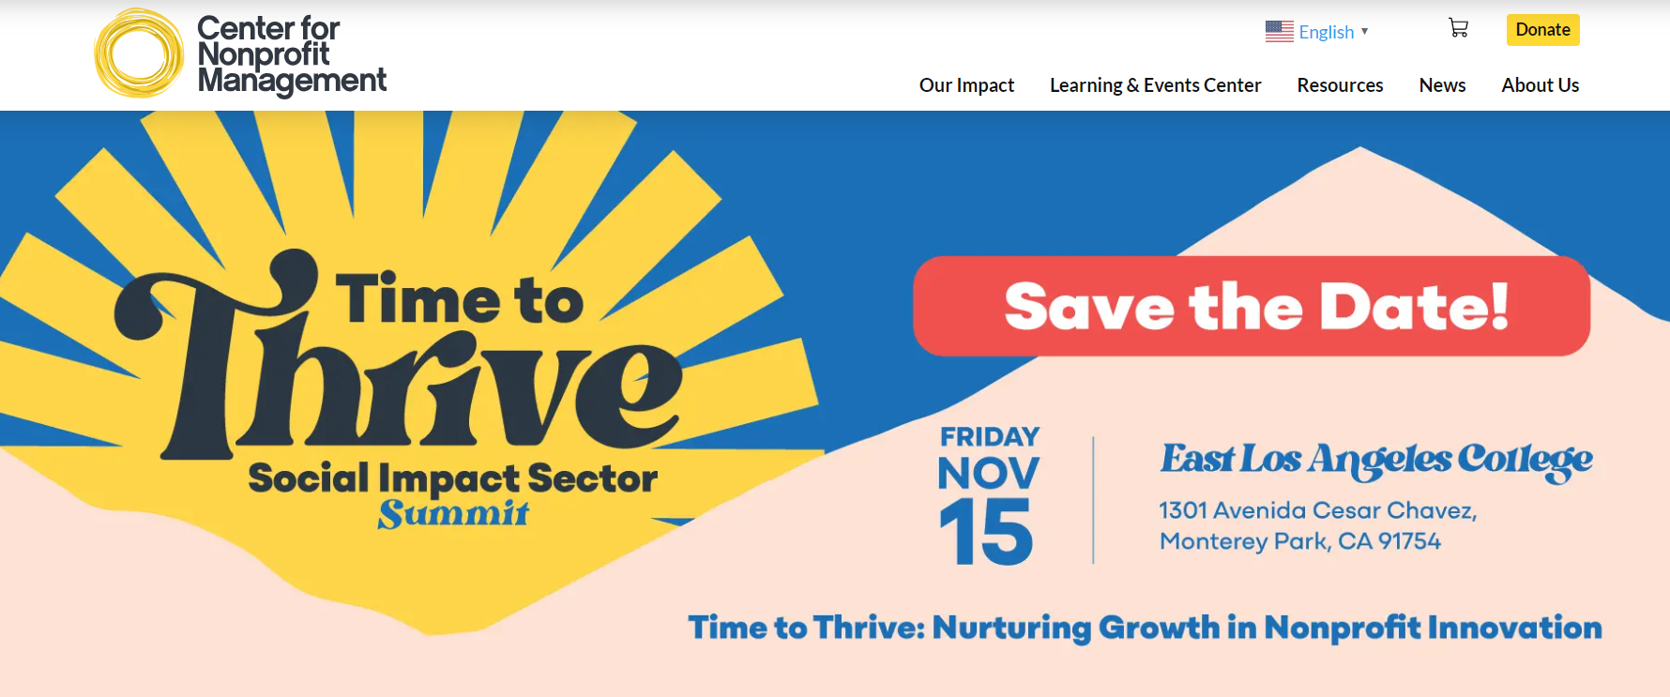
Instagram: @cnmsocal
X: @CNMsocal
Facebook: Center for Nonprofit Management/ @cnmsocal
LinkedIn: Center for Nonprofit Management
Newsletter: https://cnmsocal.org/sign-up-for-cnms-weekly-eblast/
Stay updated by joining our newsletter, following us on social media, and visiting our website regularly.

Slide 34
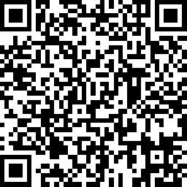
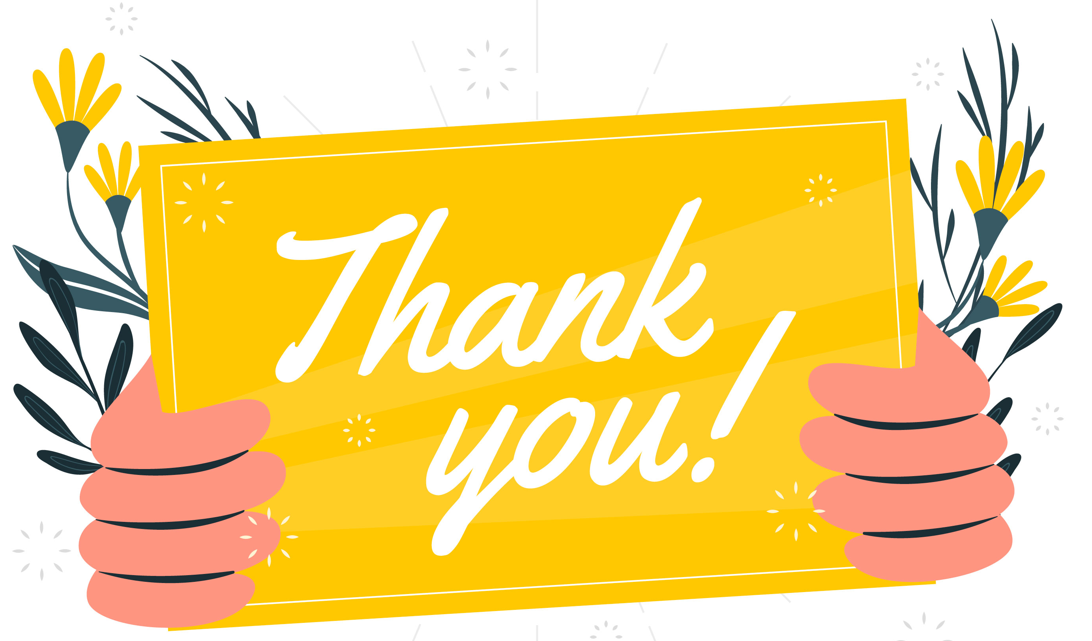
Please complete our seminar evaluation
Session Two: Leveraging your Identity as a Leader – Understanding Culture and your Identity
Main Instructor: Michelle Escamilla
34

